Slide 1
The Battle Of Neighbourhoods
Capstone Project (week 2)
Made By : Charul Gupta

Slide 2
1.Introduction :
The aim of this project is to facilitate people in exploring better facilities around their neighborhood out of number of neighborhoods .
The purpose of this project is to create an analysis of features for a people migrating to Scarborough to search a best neighborhood as a comparative analysis between neighborhoods.
The features include median housing price and better school according to ratings, and best restuaruants according to their ratings.

Slide 3
2. Data Description :
Data Link: https://en.wikipedia.org/wiki/List_of_postal_codes_of_Canada:_M Will use Scarborough dataset which we scrapped from wikipedia .
Foursquare API Data:
Foursquare is a location data provider with information about all manner of venues and events within an area of interest.
After finding the list of neighborhoods, we then connect to the Foursquare API to gather information about venues inside each and every neighborhood.

Slide 4
3. Methodology Section :
Work Flow:
Using credentials of Foursquare API features of near-by places of the neighborhoods would be mined.
Due to http request limitations the number of places per neighborhood parameter would reasonably be set to 100 and the radius parameter would be set to 500.

Slide 5
Clustering Approach:
To compare the similarities of two cities, we decided to explore neighborhoods, segment them, and group them into clusters to find similar neighborhoods
which is a form of unsupervised machine learning: k-means clustering algorithm.

Slide 6
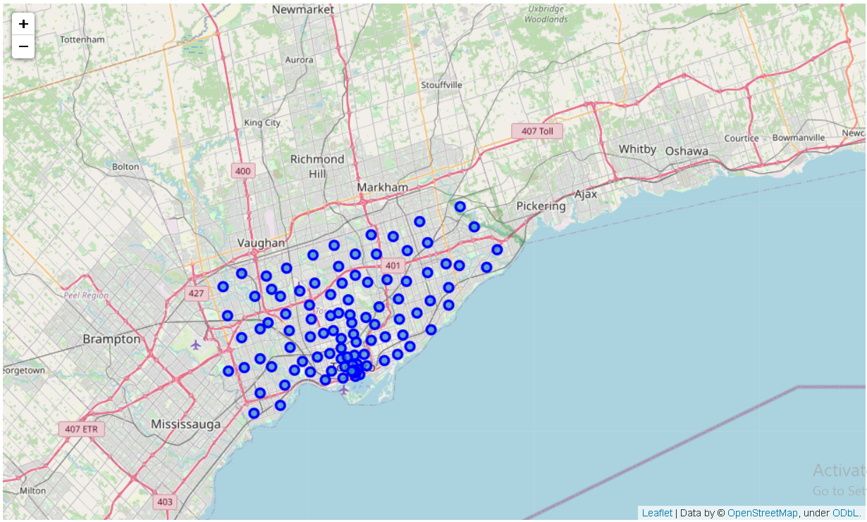
Using k-Means Clustering :

Slide 7
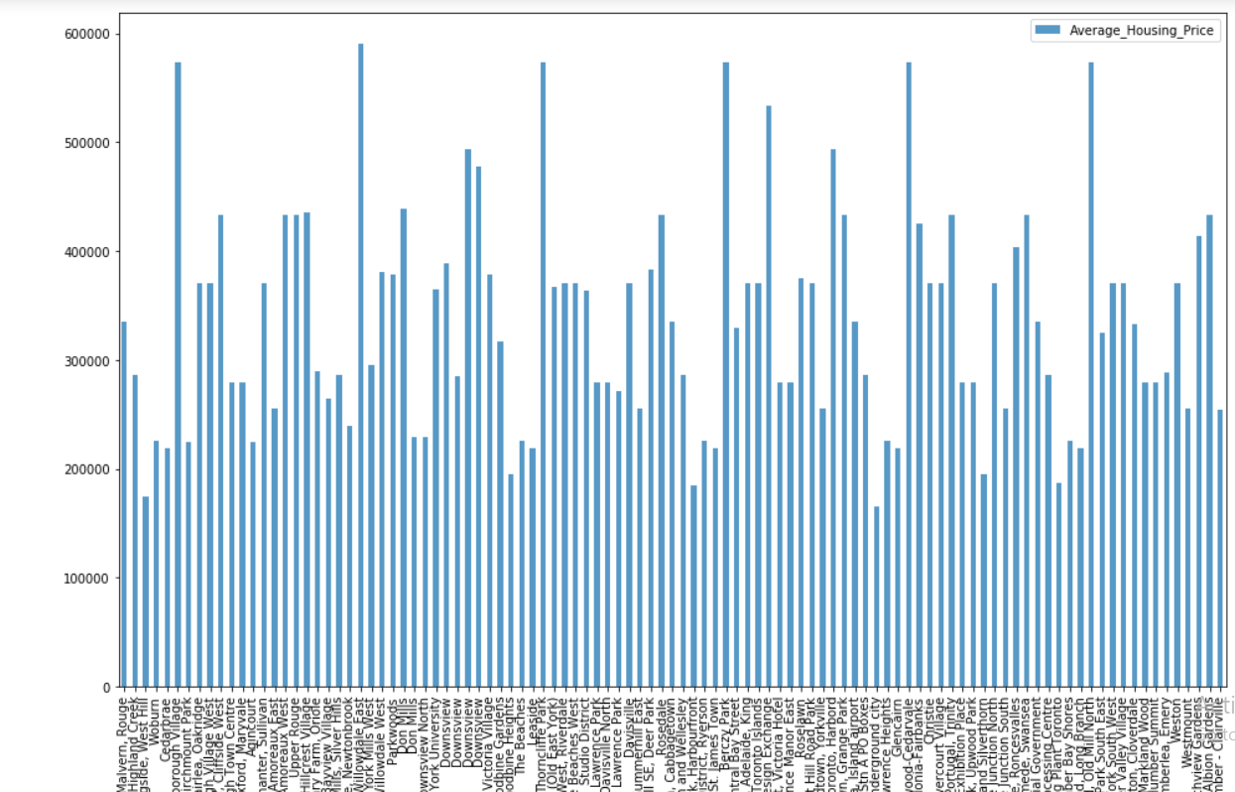
4. Result Section :
Average housing price by clusters in Scarborough

Slide 8
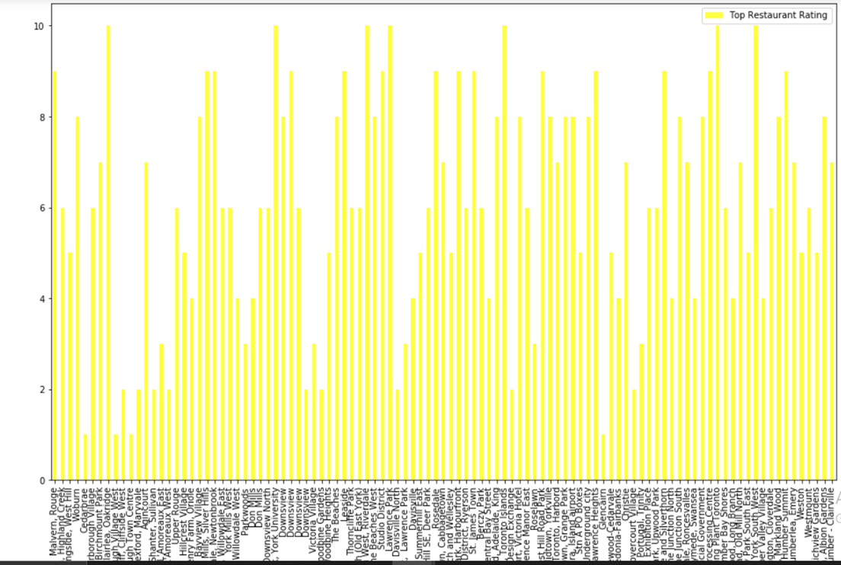
Restuarant Ratings by Clusters in Scarborough

Slide 9
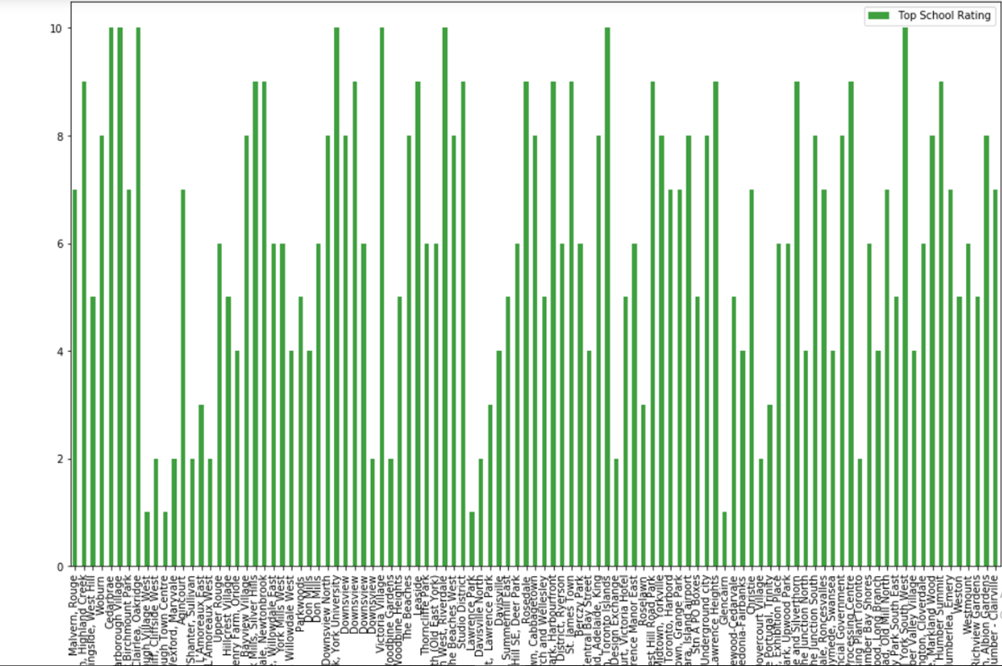
School Ratings by Clusters in Scarborough

Slide 10
5.Discussion Section :
The Problem which tried to solve –
Suggest a better neighborhood in a Scarborough
Sorted list of house in terms of housing prices in a ascending or descending order
Sorted list of Restuarants in terms of good food , services and its review and rating
Sorted list of schools in terms of location, fees, rating and reviews

Slide 11
6. Conclusion Section :
The purpose of this project was to suggest a better neighborhood in a Scarborough for the person who are shifting there.
let stakeholders make effective and smart decision based on the rents of house , nearest reach to the hospitals , schools and their work place , best market place around and friendly and like minded neighbors or colony .

Slide 12
By clustering approach we clustered data of 103 rows and then analyze them and concluded the best neighborhood for any person according to their preferences .
Final discussion on house in terms of its prices , restuarants and schools in terms of their reviews and ratings was done to suggest the best for stakeholders .

Slide 13
Thank you….

